Slide 1
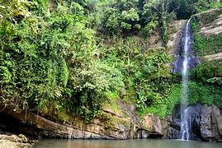
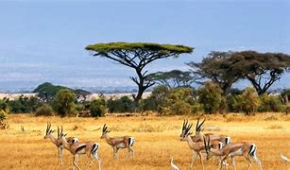
Year 2 Summer Term Topic Overview
Homely Habitats
Topic overview:
We have started our new topic which explores everything about habitats and the world around us.
We will be exploring animals and their habitats through our Science and Geography lessons and we will be reading lots of different texts that link to animals and habitats, within our English lessons. We are very lucky and will be having a visit from ‘Rent a Beast’ to introduce our animals topic.
Home learning
All children will have a share with me book to read at home. These will be changed once a week in school. Please write in the reading diary, each time your child reads at home. When reading at school children will have a different book to decode that uses the sounds they have learnt in phonics and they will read this 3 times a week.
Please remember to access times table rock stars/numbots weekly.
All homework is set on DOJO on a Tuesday and must be completed by the following Monday.
Important information:
Children will all be sent home with coloured word set cards to practise, these are the words children need to read and write in Year 2.
PE kits need to be in school everyday and all items must be named.
All children need to bring a named water bottle to school everyday.
As the weather improves, please ensure your children have sunhats within school.

Slide 2
This term we will be learning…
English | In English we will be reading fiction and non-fiction texts about animals and their habitats. We will be focussing on descriptive writing and writing a narrative. We will also explore different animals and their habitats through our non-fiction writing. | Design and Technology | In D&T we will research, design create and evaluate our very own bug habitat. We will continue to monitor any residents we may have throughout the term. We will create a card with a hinge.
Maths | In maths we will explore fractions and we will develop our understanding of measure through reading divisions of ones, twos, fives and tens. We will explore time reading time on a clock to quarter to and past the hour. We will explore position and direction through movement activities. We will look at statistics through charts and graphs. | Art and Design | Through Art we will explore the works of British sculptor Andy Goldsworthy and how he was inspired by land art. As we learn more about natural materials and habitats, we will be able to apply this knowledge when creating our bug habitats. We will also create our own tropical rainforest diorama.
PSHE | In PSHE, we will explore body language, image sharing and computer safety. We will also have a NSPCC workshop. We will complete a transition project linked with Year 3. | Music | In Music, we will continue exploring instruments and symbols. We will experiment with different instruments, We will continue to explore music using our voices expressively and creatively. We will listen to music and discuss how it makes us feel.
Geography | In Geography we will explore the world around us. We will travel all over the world, learning about woodland habitats, the polar regions, tropical rainforests and savannah grasslands. We will compare life in England for Inuit people living in different countries. | Religious Education | In RE we will begin by building on our previous learning around Christianity and Judaism. We will explore the key question ‘How should we care for others and the world, and why does it matter?’ We will also explore the key question, ‘What does it mean to belong to a faith community?’
History | In History, we will explore the concept of the nation’s history through exploring the Royal family. We will also develop our understanding of Levison Wood and compare him to an explorer from the past. | Science | In Science, we will build upon our previous knowledge in year 1 around animals. We will name a variety of animals in their habitats and describe how different habitats provide for the basic needs of different kinds of animals. We will also describe how animals obtain their food and we will learn about food chains.
Computing | In Computing, we will be exploring creating pictograms to show data and creating quizzes. | Physical Education | In our PE lessons we will be focussing on our athletic skills. We will be taking part in sports day.

